Slide 1

Integration of I 4.0 standards
Alina Arunova, Maxim Maltsev, Philipp Matyash, Sattar Rahimbeyli
Tutor: Irlán Grangel

Slide 2


Integration of I 4.0 standards
The Problem
Globalization forces large companies to go international
Multinational companies tend to consolidate the standards
Different industrial standards need to be matched
Lots of time wasted onto manual object notation transcription
2

Slide 3

Integration of I 4.0 standards
The Solution
Universal tool that:
validates each document against standard schema
matches each entity of the document to a respectful entity of another document if possible according to ontology
consolidate the knowledge into the new unified standard
3

Slide 4

Integration of I 4.0 standards
I 4.0 or Industry 4.0 is a combination of production methods with state-of-the-art information and communication technology. In the world of Industry 4.0, people, machines, equipment, logistics systems and products communicate and cooperate with each other directly.
In short, the goal of our research group is to create a web-based tool that uses RDF(S) vocabularies for integrating instances of such standards as AutomationML and OPCUA into one piece.
4

Slide 5
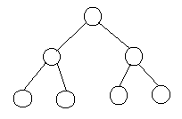
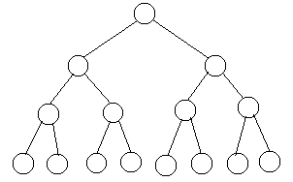
Integration of I 4.0 standards
AML – ontology
&
OPCUA – ontology
AML file
AML file
Integration file
OPCUA file
OPCUA file
All files are in XML format
5

Slide 6


Integration of I 4.0 standards
Our group will be simultaneously working on the Front end and Back end parts of the project
Front end with the Angular JS framework.
Back end part with the Java.
User interface with browsing;
Visualization of the input;
Visualization of the final result.
Input validation;
Integration with the existing model;
Testing the correctness of the result.
Before starting, a Golden Manual Input will be created in order to have a totally correct result on our hands.
6

Slide 7





Integration of I 4.0 standards
Conceptual tech stack
7

Slide 8
Integration of I 4.0 standards
Q&A?
8

